Slide 1
Eye Disease Detection Through Image Processing and Deep Learning
Machine Learning Projects
Eren Eroğlu - 2206102046
Mehmet Çelebi - 2306102023
Ulaş Salatan - 2106102020
December 2025

Slide 2
Problem Description
The Problem:
Eye diseases (Cataract, Glaucoma, Diabetic Retinopathy) are leading causes of preventable blindness.
Traditional diagnosis relies heavily on experts and expensive equipment, limiting access in remote areas.
Our Solution:
We developed an automated Decision Support System using Deep Learning.
Goal: To classify retinal fundus images into 4 categories with high precision, assisting doctors in early diagnosis.

Slide 3
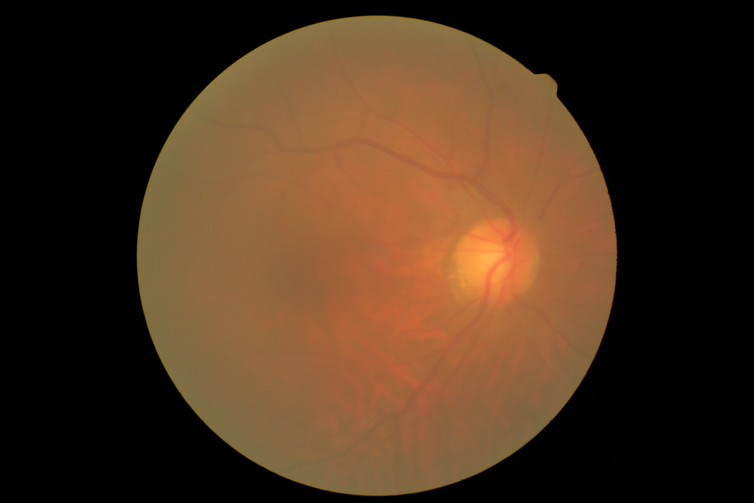
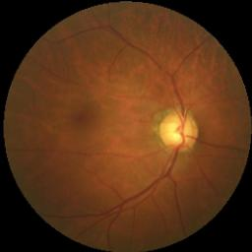
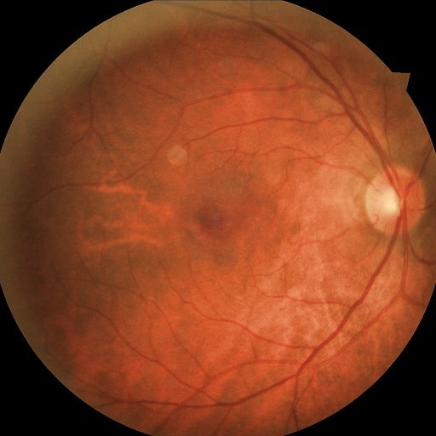
Dataset Overview
Source:https://www.kaggle.com/datasets/gunavenkatdoddi/eye-diseases-classification
Dataset Structure:
Classes: The dataset consists of 4 balanced classes
Total Images: ~4,200 Retinal Fundus Images
Preprocessing Steps:
Resizing: Images converted to 224x224 pixels (VGG16 standard).
Normalization: Pixel values scaled to [0, 1] range.
Augmentation: Applied rotation, zoom, and horizontal flip to prevent overfitting.

Slide 4
Methodology
Base Model: VGG16 (Pre-trained on ImageNet).
Advanced Fine-Tuning:
Instead of just training the output layer, we unfroze the last 8 layers.
This allowed the model to learn specific features of eye diseases (e.g., optic disc changes, lesions) rather than just general shapes.
Handling Imbalance:
We implemented Class Weights to penalize the model more for missing disease cases. This forced the model to focus on detecting diseases rather than defaulting to "Normal".
Optimization:
Optimizer: Adam (Learning Rate: 1e-5).
Callbacks:ReduceLROnPlateau (for stable convergence) and EarlyStopping (to prevent overfitting).

Slide 5
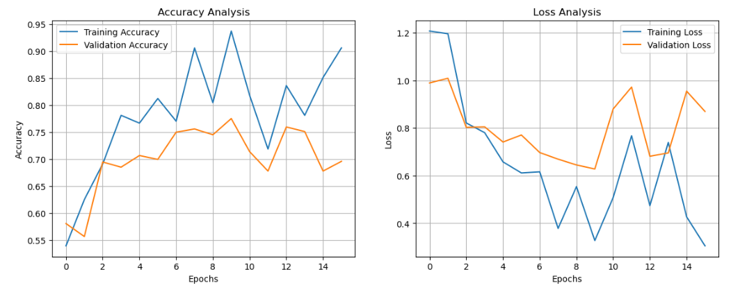
Performance Metrics - Training
Training Analysis:
The model was trained for 25 Epochs (Stopped early at Epoch 16).
Observation: The "Loss Graph" shows a step-down pattern. This indicates that the Learning Rate Scheduler successfully optimized the training by lowering the learning rate when validation loss plateaued.
Result: The model converged without overfitting.

Slide 6
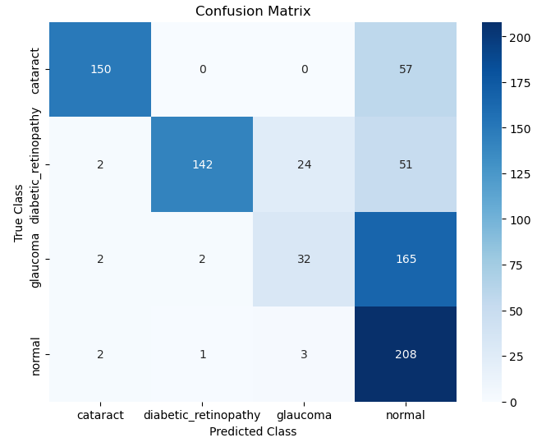
Error Analysis 1 (Confusion Matrix)
Visualizing Predictions:
The Confusion Matrix shows how the model classifies each category
Key Findings:
Cataract: 150 correct out of 207
Diabetic Retinopathy: 142 correct out of 219
Glaucoma:The model correctly identified 32 cases but misclassified 165 Glaucoma cases as "Normal".
Reason: Unlike Cataracts, Glaucoma does not cause obvious retinal lesions. It affects the optic disc geometry, which is difficult for standard CNNs to detect without specific segmentation.

Slide 7
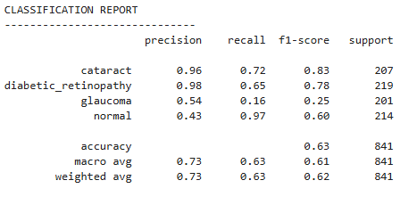
Error Analysis II (Statistical Metrics)
Precision & Reliability:
Cataract (0.96) & Diabetic Retinopathy (0.98): The model achieves near-perfect precision. This means if the model predicts a disease, the diagnosis is highly reliable.
The Trade-off:
While precision is high, Recall varies.
The model adopts a conservative approach, preferring to be "sure" rather than raising false alarms. This is crucial for medical screening tools to maintain trust.

Slide 8
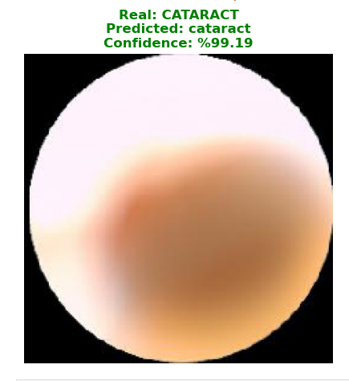
Real-World Test (Live Demo)
Testing on Unseen Data:
We tested the final model on a random Cataract image that was not part of the training set.
Conclusion:
The model is highly reliable for detecting cataracts with near-perfect confidence.

Slide 9
Conclusion & Future Work
Summary:
Successfully built a Deep Learning model using Transfer Learning.
Optimized with Fine-Tuning and Class Weights to prioritize disease detection.
Achieved 99% confidence in real-world Cataract testing.
Future Work:
Implement Optic Disc Segmentation to further improve Glaucoma detection.
Deploy the model as a Mobile App for doctors in remote areas.

